Slide 1
Analysing the Impact of Car Features on Price and Profitability
Final Project-3
Chetan Vishwakarma

Slide 2
PROJECT DESCRIPTION:
The project analyses the relationship between the car’s features, market category, and pricing identifying which features and categories are most popular among consumers and most profitable for the manufacturer.
The Dataset Consists of Columns that contain details like make, model, year of manufacture, Type of engine, vehicle, and many more, and the target column in the dataset is Car MSRP i.e. Price of the car
• APPROACH: Firstly, an analysis of the dataset was done, In which we needed to find the missing values in each column and then replace the values with the help of Descriptive statistics like mean, median, and mode.
Mean and median values are used in numerical values while mode is used in categorical columns for the replacement of the missing values in each column of the dataset.
Columns like Engine fuel type, Engine HP, Engine cylinders, and No. of doors contains Missing cells and some columns even contain N/A values.

Slide 3
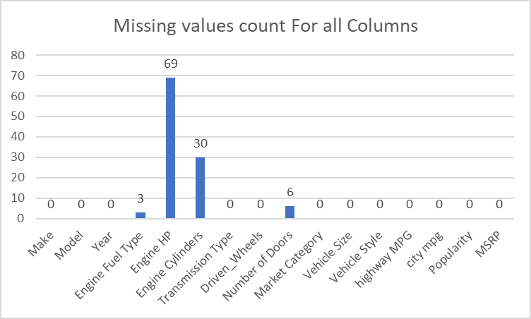
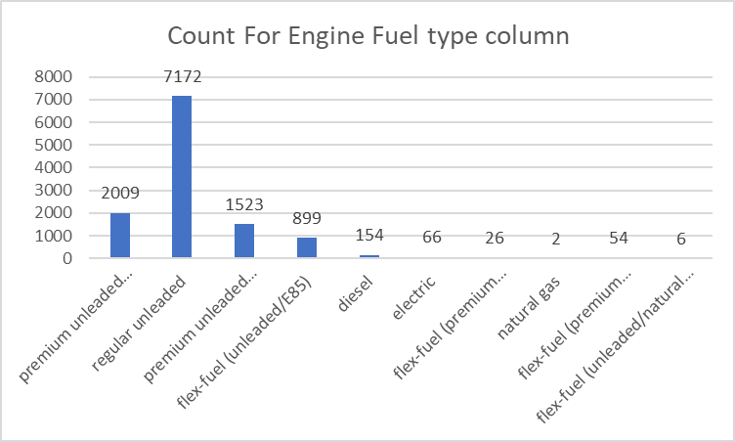

Slide 4
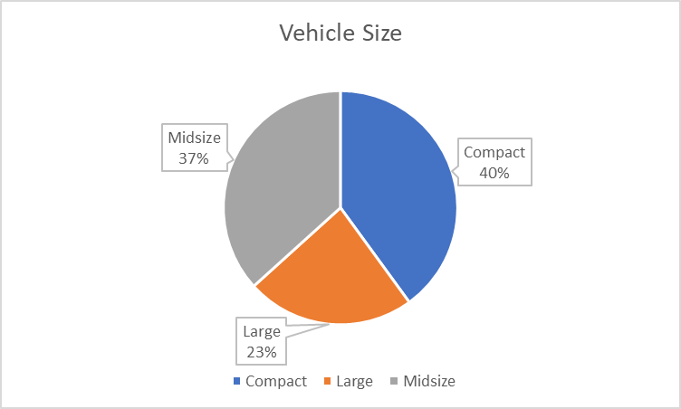
TECH -STACK USED: Microsoft Excel 2019 was used for the analysis of the dataset.Pivot tables and Charts were also used for visualizing the data. Microsoft PowerPoint was used for writing the project’s description
INSIGHTS: The following insights were drawn based on understanding and capabilities:
There is a statistically equal distribution of data with respect to the vehicle size column.
Data about the sedan classes is maximum.
There are maximum No. of Car with Automatic Transmission system
Data about Chevrolet Cars are the maximum followed by Cars manufactured by Ford.
Maximum No. of cars have Front wheel drive system

Slide 5
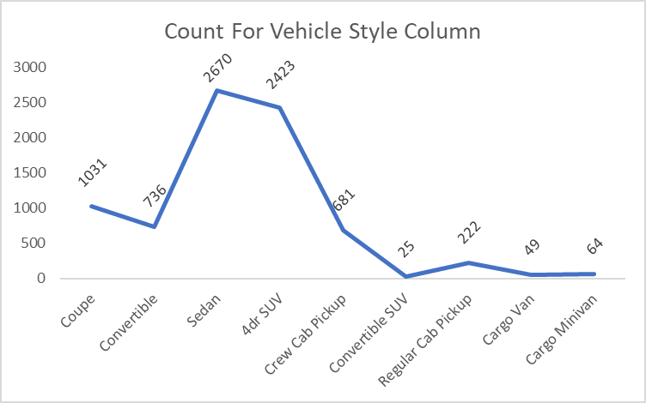
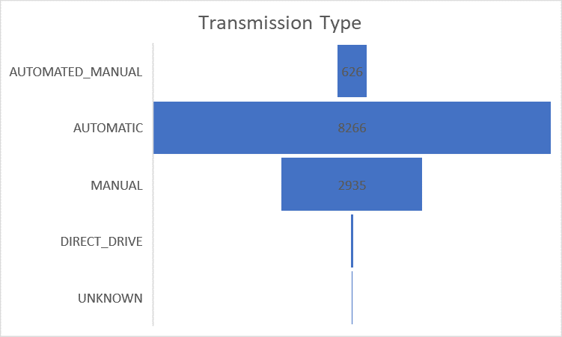

Slide 6
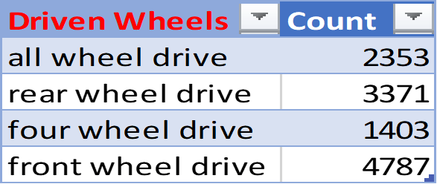
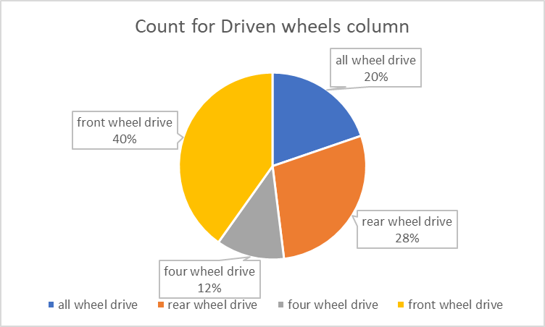
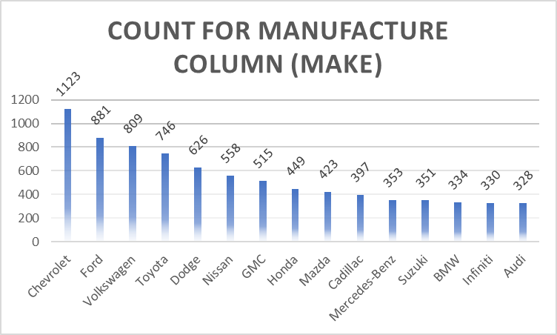

Slide 8
Task 1.A: Create a pivot table that shows the number of car models in each market category and their corresponding popularity scores.

Slide 9
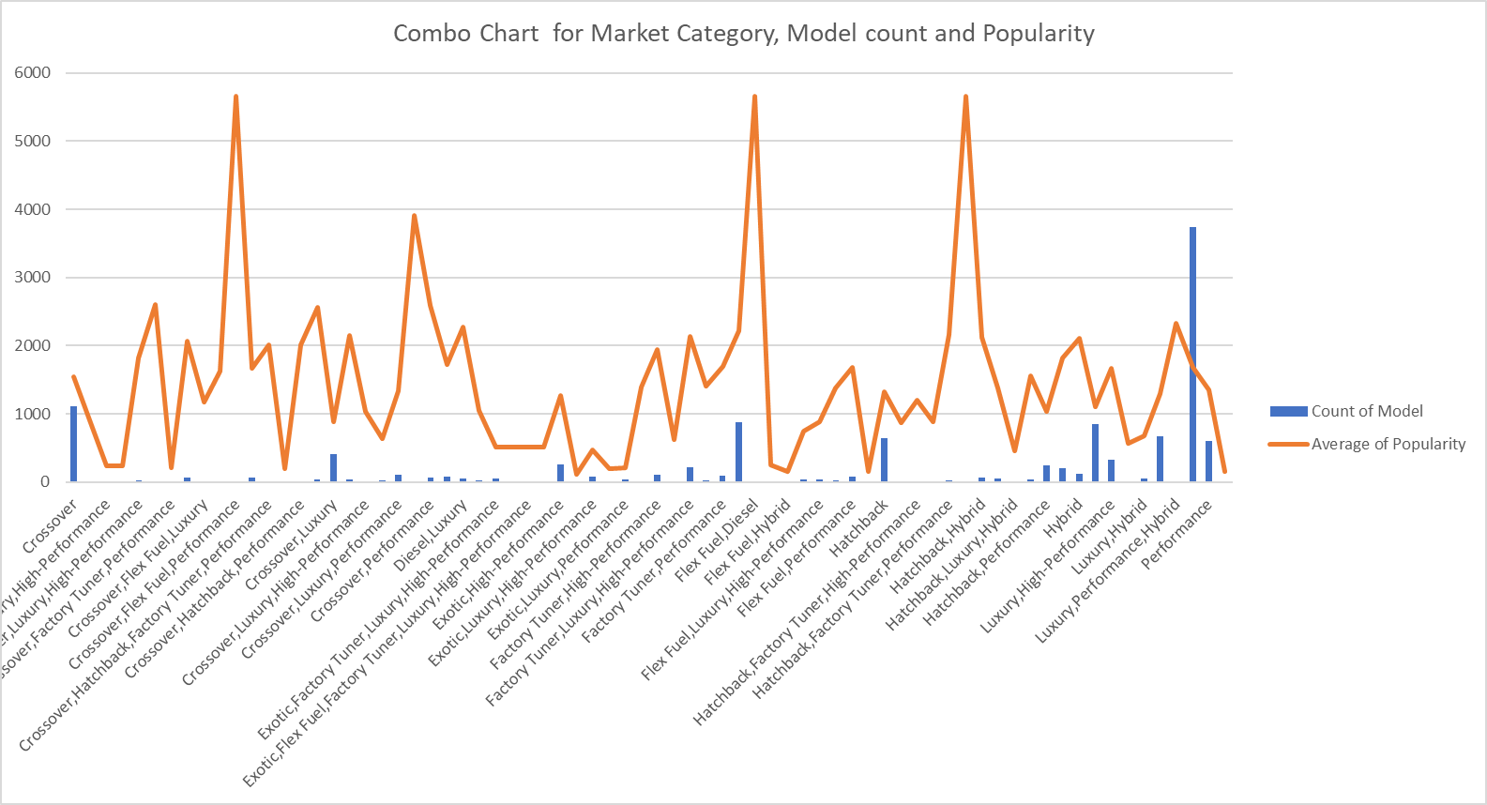
Task 1.B: Create a combo chart that visualizes the relationship between market category and popularity.

Slide 10
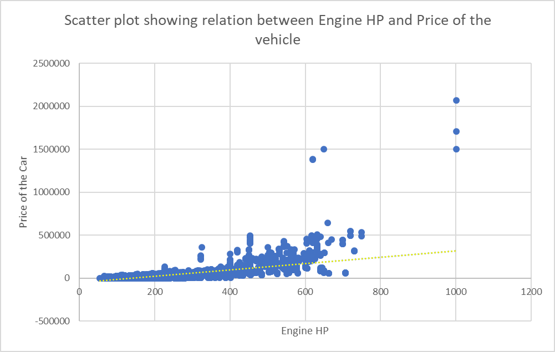
Task 2: Create a scatter chart that plots engine power on the x-axis and price on the y-axis. Add a trendline to the chart to visualize the relationship between these variables.
The scatter plot shows a Positive Relationship between the columns like Engine Horsepower and the Price of the Car (MSRP).
Outliers in the data do not affect much of the slope of the Trendline, Hence Left untouched

Slide 11
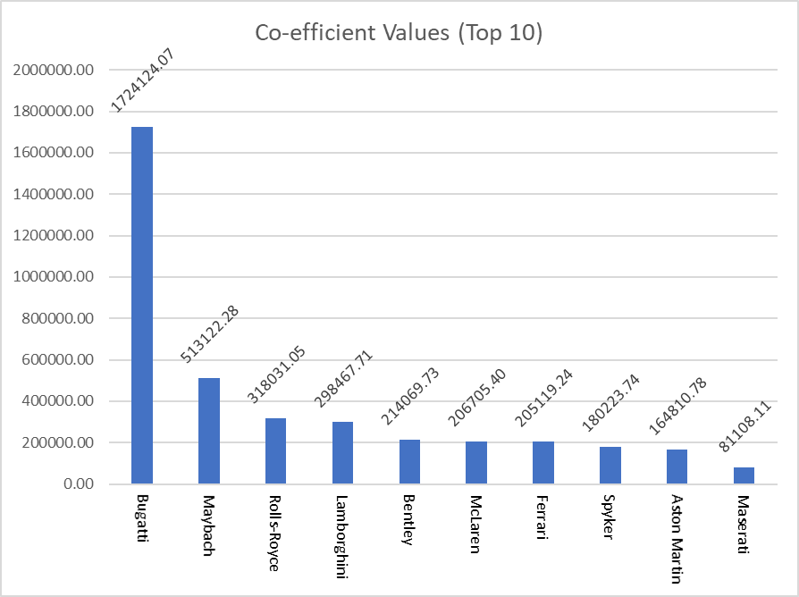
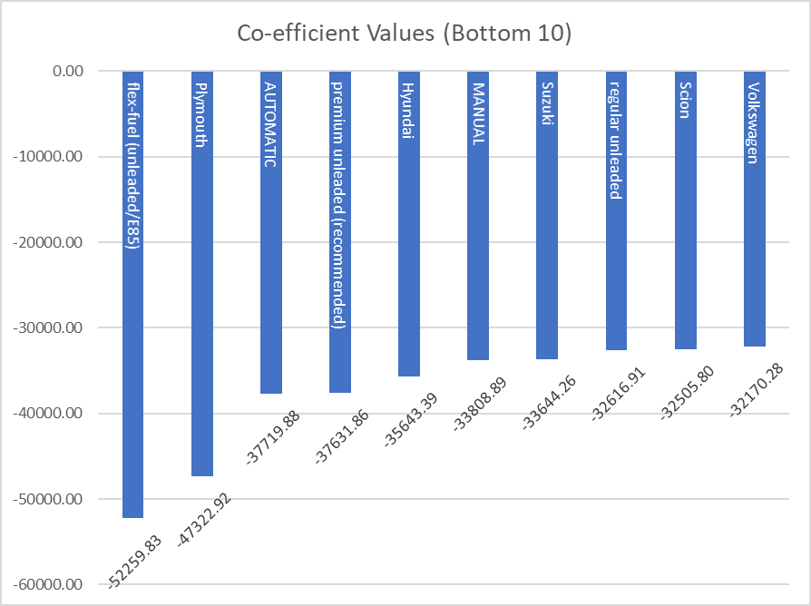
Task 3: Use regression analysis to identify the variables that have the strongest relationship with a car's price. Then create a bar chart that shows the coefficient values for each variable to visualize their relative importance.

Slide 12
For the Regression Analysis of the data, We used the Data analysis Function In which the Y-variable was kept for the target column i.e. MSRP (Price of the car) and X-variables were all the other columns listed in the table, and their respective Co-efficient values are also listed in the table

Slide 13
Task 4.A: Create a pivot table that shows the average price of cars for each manufacturer.
Maximum Average MSRP obtained is for Bugatti Cars followed by Maybach and Rolls-Royce.
Cheapest Cars on the list are Plymouth followed by Oldsmobile and Suzuki Cars.

Slide 14
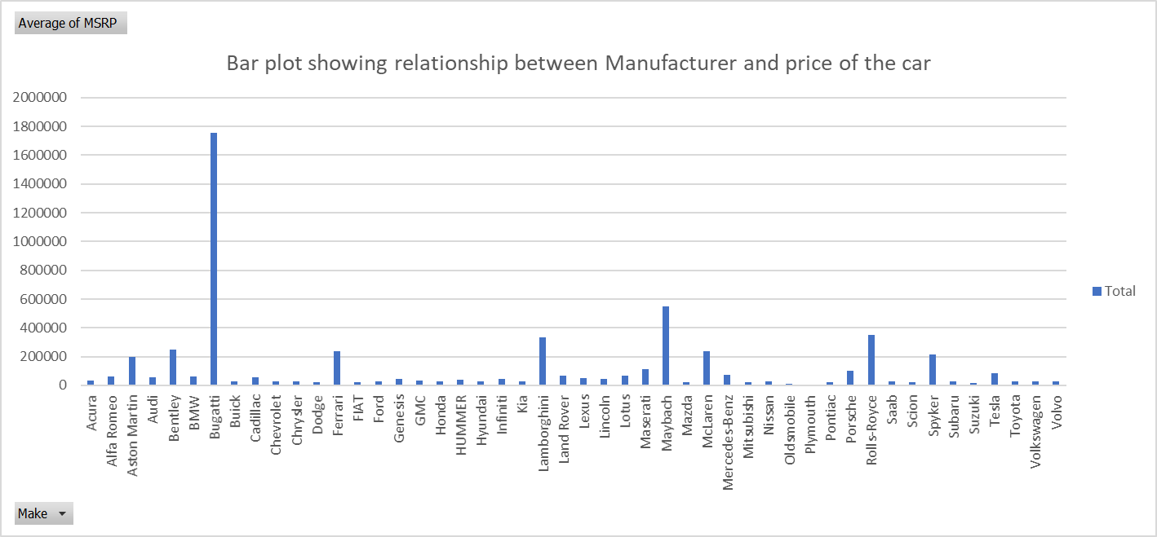
Task 4.B: Create a bar chart or a horizontal stacked bar chart that visualizes the relationship between manufacturer and average price.

Slide 15
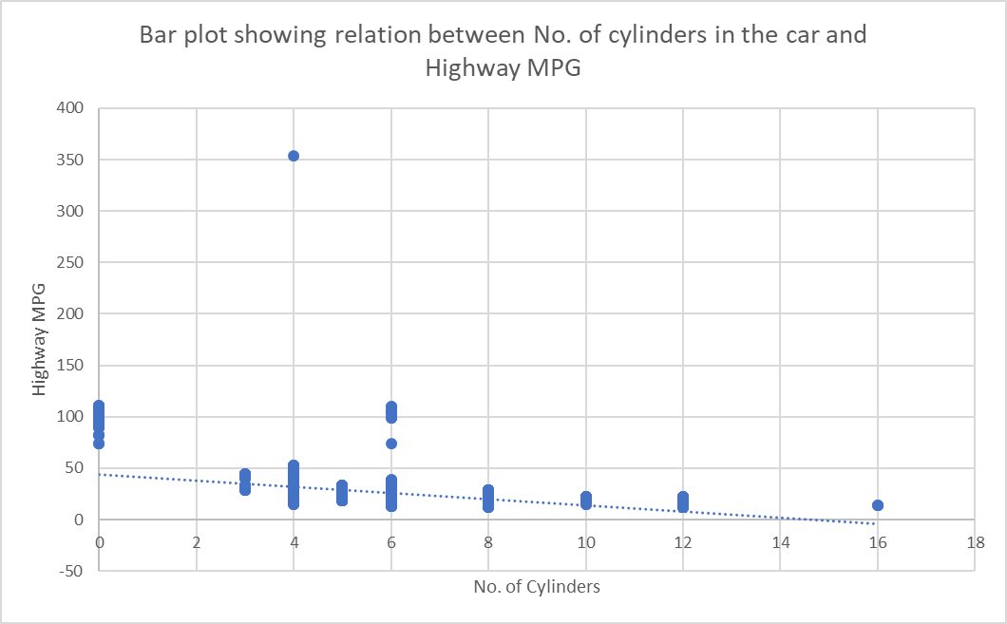
Task 5.A: Create a scatter plot with the number of cylinders on the x-axis and highway MPG on the y-axis. Then create a trendline on the scatter plot to visually estimate the slope of the relationship and assess its significance. Task 5.B: Calculate the correlation coefficient between the number of cylinders and highway MPG to quantify the strength and direction of the relationship.
The bar chart shows the Negative relationship between the columns like No. of cylinders and Highway MPG.
Correlation-Coefficient for both columns is

Slide 16
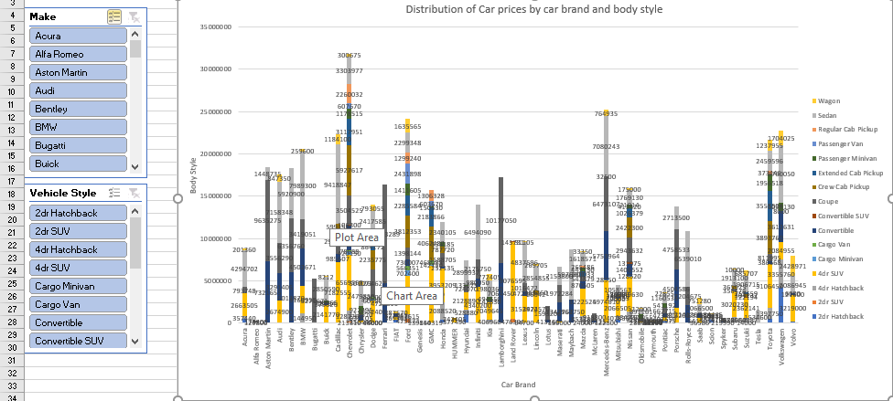
DASHBOARD ASSIGNMENTS: Task 1: How does the distribution of car prices vary by brand and body style?

Slide 17
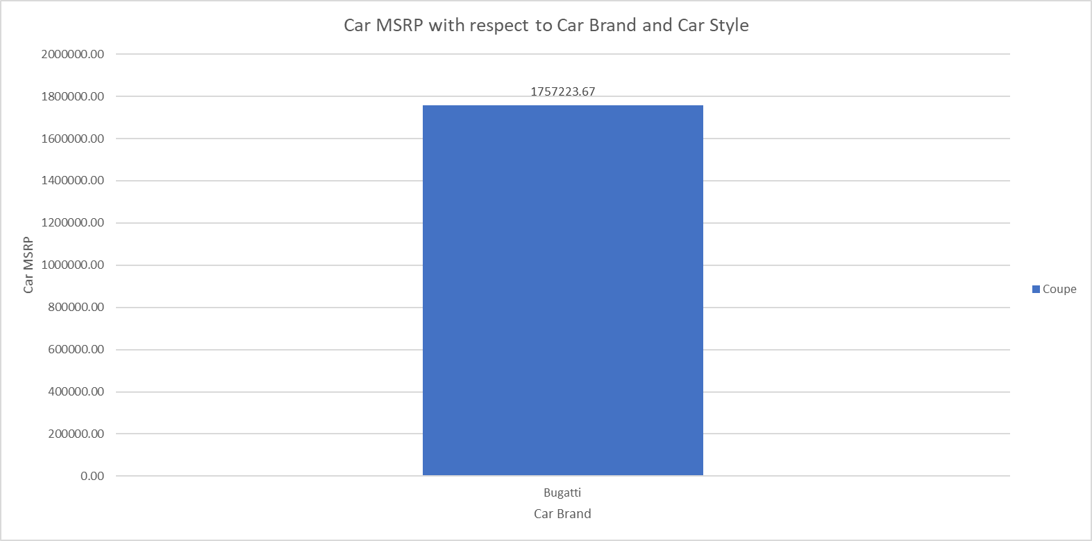
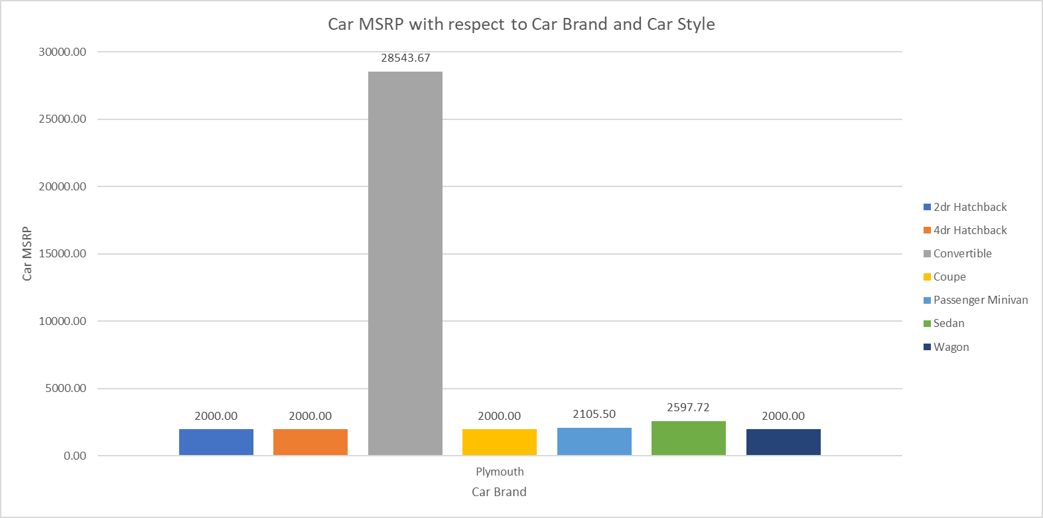
Task 2: Which car brands have the highest and lowest average MSRPs, and how does this vary by body style?

Slide 18
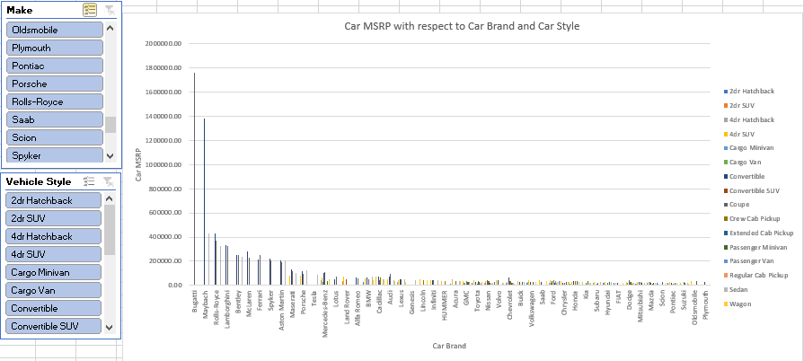

Slide 19
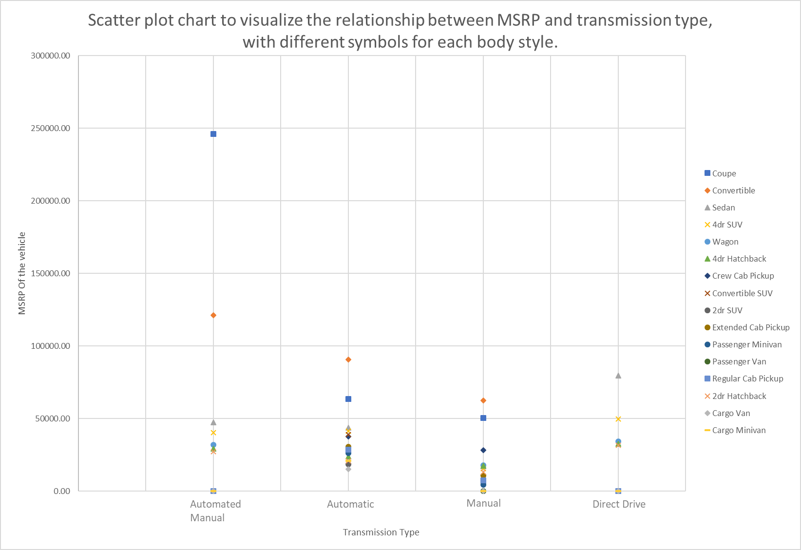
Task 3: How do the different features such as transmission type affect the MSRP, and how does this vary by body style?

Slide 20
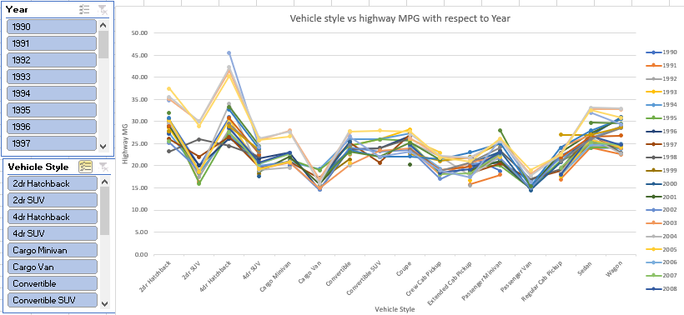
Task 4: How does the fuel efficiency of cars vary across different body styles and model years?

Slide 21
Task 5: How does the car's horsepower, MPG, and price vary across different Brands?

Slide 22
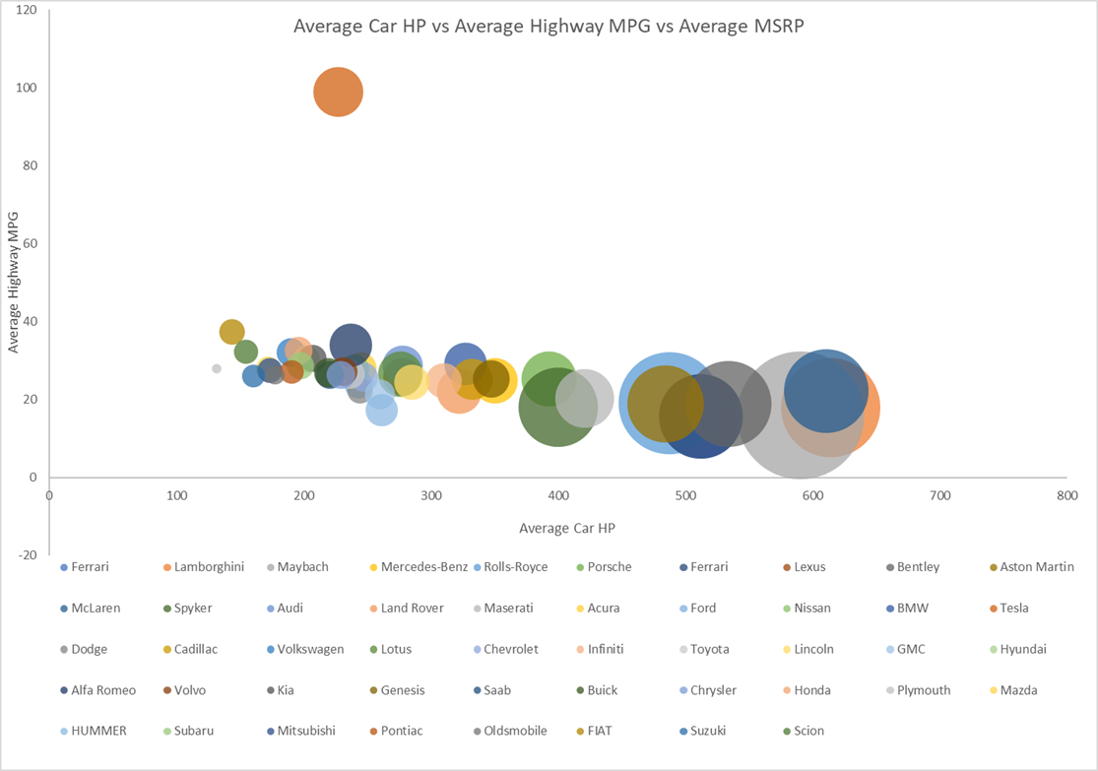

Slide 23
Conclusion
The price of the car mainly depends on the Brand i.e. Manufacturer and Model of the car.
Increase in No. of Cylinder and engine horsepower leads to a decrease in the City and Highway MSRP.
Cars with electric Fuel type have a High Highway MPG followed by Natural gas and Diesel-driven type engines.
An increase in Engine HP decreases the Mileage of the engine but increases the Price of the Vehicle.
There was a downfall in Vehicle’s highway MPG in the Year 2000 then there was a gradual increase with respect to the increase in Year and Price

